Slide 1
Chat GPT Chandrakant SM Keonics Hubli

Slide 2
PROBLEM and how technology solves it
A person is having 1,00,000 Rs and he wants to deposit the amount and wants to earn interest on it. He wants to earn maximum interest and the safety of the amount also.

Slide 3
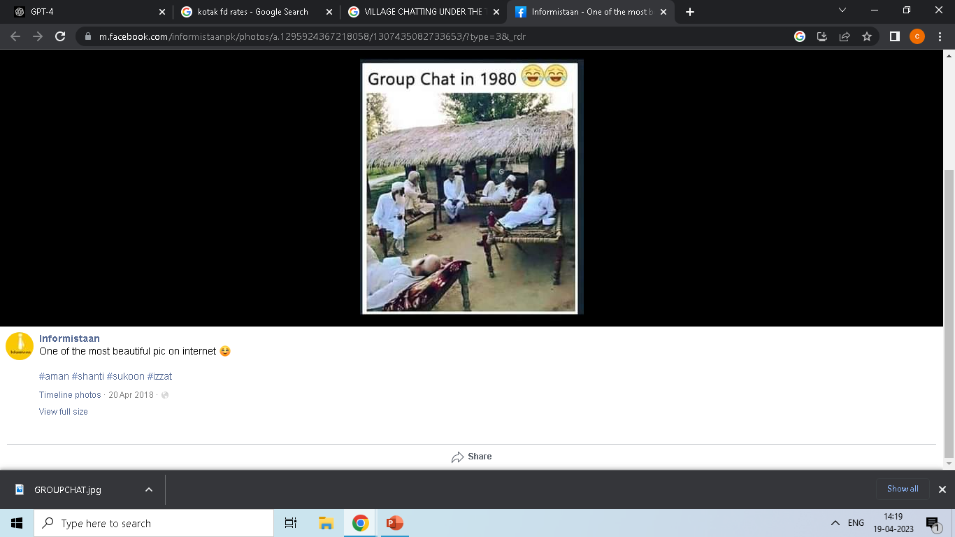

Slide 4
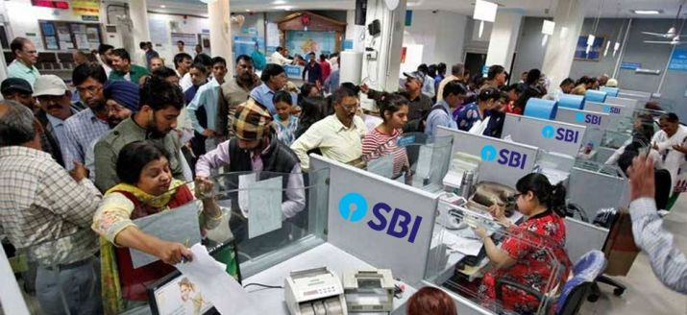
DURING 1990

Slide 5
2000s
www.yahoo.com $$$
www.msn.com Hotmail.com gmail.com
@@@@ www.sbi.com
www.canbank.com
www.rbi.com @@@
www.icicibank.com
www.hdfcbank.com www.pnb.com
www.karnatakabank.com

Slide 6
we seek information from the net. This process evolving day by day , as the technology changes. It evolved thru search engine (google , bing etc). It searches the feedin key words thru all the websites where its used most number of times and it throws them on the screen.

Slide 7
Lets search Fd rates on google search engine
2010s
The search engines

Slide 8
Companies develop chabots to automate the process of interaction between the staff and the customers Lets take example of a bank, where in 5000 employees work, and thru the day they answer customer queries like account opening, fds, where is the branch , complaints, loans. These are the interactions happen between the customers and the bank staff. This process is automatedd thru CHAT BOX

Slide 9
Lets have quick demo of chatbot ex : kotak keya

Slide 10
GPT: Generative Pre-trained Text open AI
The "Generative" in GPT represents its ability to generate natural human language text.
The "Pre-trained" represents the fact that the model has already been trained on some finite dataset. Much like you'd read a book or maybe several books before being asked to answer questions about it.
The "Transformer" represents the underlying machine-learning architecture that powers GPT.

Slide 11
How chat gpt is trained?
Supervised learning
A teacher giving student 100 essaes to read
Reinforced learning
A teacher now gives feedback by differentiating between a good and bad essay
This is similar to the reinforcement learning stage of training the GPT model. After being fed a massive amount of text scraped from the internet, the model can answer questions. However, its accuracy is not going to be good enough. Human trainers ask the model a question and provide feedback on which answer is more appropriate for each question.

Slide 12
Future of chat gpt.
Customer service: 24/7 customer service support. answering frequently asked questions, providing troubleshooting assistance, and offering product recommendations.
Marketing: analyzing customer interactions This information can help companies improve their marketing strategies and create more effective campaigns.
Recruitment: Assisting with resume screening, conducting initial interviews, and providing feedback to candidates.

Slide 13
THANK YOU
For being in the right place @ the right time
Congrats
For being also

